Slide 1

SUPERSTORE SALES PERFORMANCE REPORT
Presented by ;
G Mahalakshmi
DADS-Feb Online Batch

Slide 2
Executive Summary(from Overall Summary Or Cleaned Data )
Purpose: Give a bird's eye view of sales performance.
Content:
📌 Total Sales: $X,XXX,XXX
📌 Total Profit: $XXX,XXX
📌 Total Orders: XXXX
📌 Average Discount: X%
📌 Top Region: e.g., West
How:
Open Cleaned Data Or Overall Summary
Use a table or chart
Manually copy values into bullet points or draw a simple shape-based layout

Slide 3
Sales Trends Over Time( Time_Analysis )
Purpose: Show how sales evolved over months or years
Content:
Line chart or bar chart of Sales by Month
Note seasonal spikes or drops
Key Points:
📈 Sales peak in Q4 (e.g., November & December)
📉 Low sales in summer months
🧠 Opportunity: Run promotions during low seasons
How:
Use the chart in Time_Analysis, copy it as an image, and paste it into the slide

Slide 4
Category-wise Performance ( Category & Insights )
Purpose: Compare sales and profit across categories
Content:
Bar chart of Sales & Profit by Category
Optionally break down into Sub-Categories
Key Points:
✅ Best-performing Category: e.g., Technology
⚠️ Least Profitable: e.g., Furniture
💡 Focus on bundling or pricing for low-margin products

Slide 5
Shipping Mode & Product Insights ( Ship Mode & Product )
Purpose: Analyze how shipping methods impact product sales
Content:
Pie chart of Sales by Shipping Mode
List or bar chart of most shipped products
Key Points:
📦 Most common method: e.g., Standard Class
🚀 Fastest method (e.g., Same Day) has lower usage
🧠 Suggest optimizing delivery cost vs customer preference

Slide 6
Top Products / Customers ( Cleaned Data )
Purpose: Show high-value customers and best-selling products
Content:
Table or bar chart: Top 5 Products
Table or bar chart: Top 5 Customers
Key Points:
🌟 High-value customers contribute major revenue
📦 Best-sellers often belong to a specific category (e.g., Phones, Chairs)
✅ Upsell or loyalty potential

Slide 7
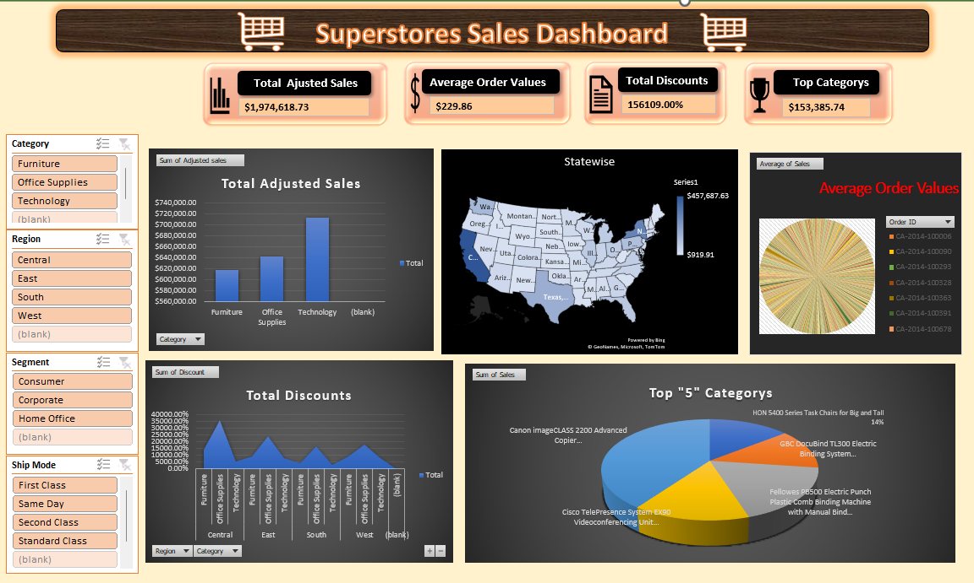
Dynamic Dashboard Screenshot
Purpose: dashboard visuals from Excel
Content:
Screenshot of your dashboard with charts and slicers

Slide 8
Recommendations
Purpose: Suggest actions based on insights
Content:
📌 Promote Technology category further
📌 Optimize Furniture pricing or discount structure
📌 Run marketing in Q3 to balance low season
📌 Encourage cost-effective shipping options
📌 Start loyalty campaigns for high-value customers

Slide 9


